Slide 1
Mike’s Podcasting Primer\ (What To Do Even If You Knew Nothing About Podcasting)
Call 770-826-3662 today!

Slide 2
What We Will Learn Today
How to get a Podcast URL and hosting easy and cheap Why having a dedicated Wordpress website to control your content is important compared other easy options (Anchor, Libsyn, PodBean) Which directories to submit your RSS feed to and why My show formula 80/20 rule of content vs shameless self promotion The software and mics from cell phone apps to usb mic and computer software What are show notes, titles, tags, and backlinks that build your audience Social Media to build audience and get ideas of what they want to hear
How to profit with a superfan audience. Your own products, affiliates, listener support or advertisers. Resources and links to the things like Audcacity, Voice Record App
Podsafe production music, David Hooper's book, Mics and hardware

Slide 3
Why Podcasts are Talk Radio The World Loves and What Radio is NOT
Podcasts are talk radio shows that fans love and want to hear more Podcasts are on demand, and bingeable Podcasts can be subscribed to in directories and the user’s devices will notify when new shows are posted via power of RSS Podcasts are popular on mobile phones, tablets, TVs, Alexa/Google Home devices and the dashboards of cars
Podcasts generally only promote or advertise what their audience is interested in or can be ad free
Podcast are indexed in Google, create traffic to websites, can be shared by fans
Everyone is welcome to start a podcast and build fans worldwide..for pennies

Slide 4
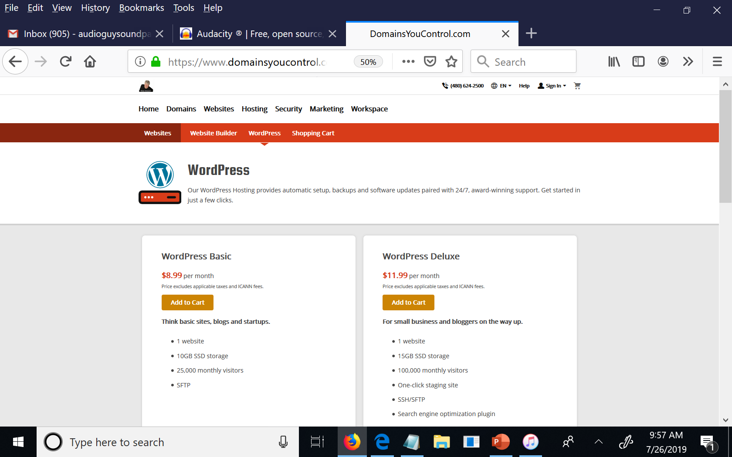
How To Get Podcast URL & Cheap Hosting
URL address .com or .live is same as call letters in radio (WNBC or KABC)
Managed Wordpress Web Hosting manages content (text, photos, links & audio) and is your transmitter
http://domainsyoucontrol.com/

Slide 5
Why a Wordpress CMS is a MUST!
The most successful podcasts in the world use a self-hosted Wordpress website on which to build their shows, show notes and monetization links
Wordpress is easy, supported everywhere (YouTube tutorials by the 1000’s)
Google loves SEO created by Wordpress and SEO plugins All your shows are indexed as search results in Google, & it builds your RSS feed
Over 40,000 free plugins for Wordpress, and 1000’s of FREE Themes
You are building your audience on a system you own for life, not some else’s platform.. Remember MySpace, Google Plus, Periscope? (all dead systems)
Professional hosting solutions like Libsyn, Podbean and BluBrry work seamlessly with Wordpress analytics and dynamic ad insertion
If the big boys use Wordpress, you should too!

Slide 6
The Podcast Directories You Must Be In!

Slide 7
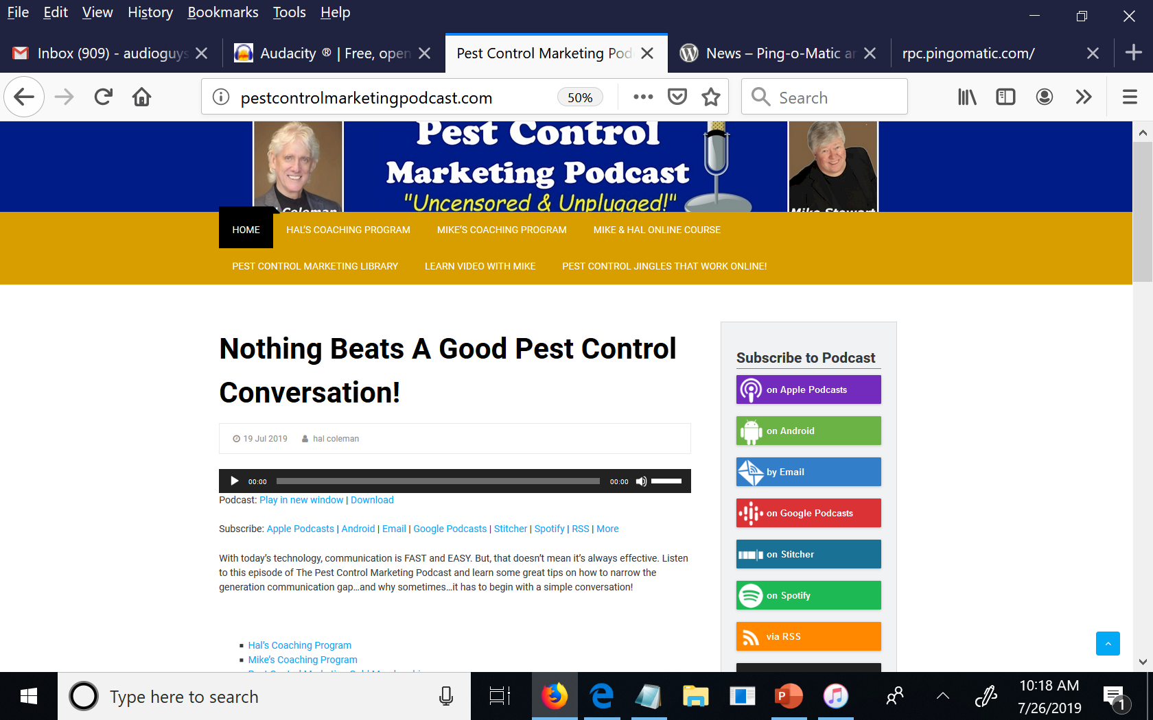
80/20 Rule of Content & Self Promotion
This what we do that works for our audience.
Music intro with self promo intro every time.
15-20 minutes of killer content interviews that audience loves and gets value from
A self promotional mid roll 60 second ad for things we do, we are our only advertiser
We end with a shameless self promotion tag We remind our listener to: Subscribe to us, share us, visit our links, subscribe to our email, buy our products and services

Slide 8
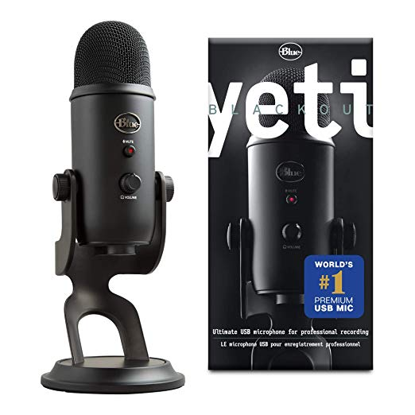
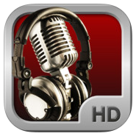
Beginner Studio Options – Software, Apps, Mics
Audacity PC and Mac Recording Software
Record Voice Pro iPhone & Android Record App
USB Mic, Too Many Others To List, But This One Cheap, and Works
Links will be at end of presentation in resources slides

Slide 9
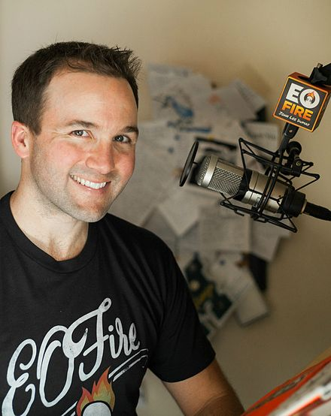
Show Notes, Titles, Subscribe Links & Backlinks – John Lee Dumas Successful Podcaster
Title
Back links to profit
Back links to profit
Back links to profit
Subscribe
Show Notes
John Lee Dumas

Slide 10
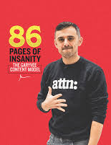
Social Media Audience Building & Engagement

Slide 11
Social Media Audience Building & Engagement

Slide 12
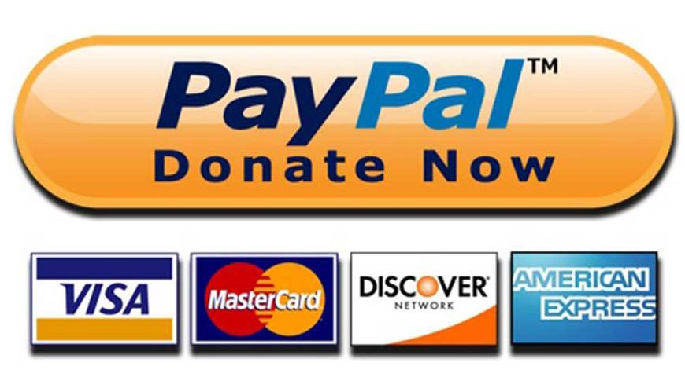
Make Money When You Have Fans
Refer fans to things that make you money, your products and services, affiliate products and services, virtual merchandise, and live events or shows
Or find advertisers who will support your show. $15 per 1000 downloads is average.

Slide 13
Tools and Resources, You Need To Know\
Free PC and Mac Software to Record & Edit
https://www.audacityteam.org/
https://apps.apple.com/us/app/voice-record-pro/id546983235
https://play.google.com/store/apps/details?id=ca.bejbej.voicerecordpro&hl=en_US

Slide 14
Tools and Resources, You Need To Know\
https://amzn.to/30VdgK8

Slide 15
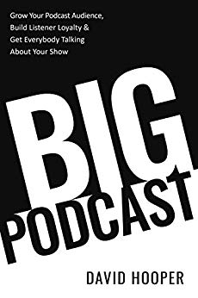
Tools and Resources, You Need To Know\
https://amzn.to/2SHA9xZ

Slide 16
Tools and Resources, You Need To Know\
https://amzn.to/2SQTtsJ

Slide 17
Tools and Resources, You Need To Know\
https://amzn.to/2ygaUcA

Slide 18
Tools and Resources, You Need To Know\
https://onlinevideolegalmusic.com/

Slide 19
Pull Out Your Phone Right Now.. Dial – (615) 205-7711
Get instant access to my slides, resource links and my free blogging course, Gary Vanynerchuk Content Marketing Model
Thanks for your time!

